Slide 1
Instagram User Analytics

Slide 2
Project Description
This project aims to analyze user data from Instagram to support marketing initiatives and provide valuable insights for investors.
The goal involves identifying loyal and inactive users, determine contest winners and commonly used hashtags, user engagement patterns, potential fake accounts and giving detailed report to the investors.

Slide 3
Approach
Database Setup: I used the provided instructions to create and set up the database. Ensured that all the data is imported correctly.
Query Development: Writing SQL queries to extract the necessary information for each task.
Data Analysis: Analyzed the results of the SQL queries to get insights.
Report Preparation: Prepare a Report/PPT with SQL queries, outputs, and insights.

Slide 4
Tech-Stack Used
Microsoft Power Point
MySQL Workbench: For writing and executing SQL queries.
Version: 8.0.37 Community Edition

Slide 5
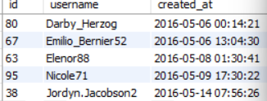
A) Marketing Analysis: Loyal User Reward
The marketing team wants to reward the most loyal users, i.e., those who have been using the platform for the longest time.
My Task: To Identify the five oldest users on Instagram from the provided database.
QUERY:
OUTPUT:
List of five oldest users on Instagram.

Slide 6

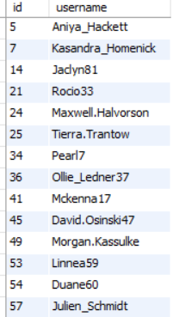
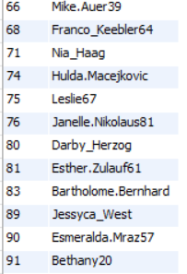
Inactive User Engagement
The team wants to encourage inactive users to start posting by sending them promotional emails.
My Task: Identify users who have never posted a single photo on Instagram.
Query:
Output:
List of users who have never posted a photo.

Slide 7
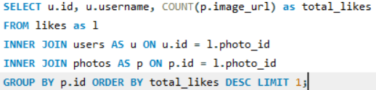

Contest Winner Declaration
The team has organized a contest where the user with the most likes on a single photo wins.
My Task: Determine the winner of the contest and provide their details to the team.
Query:
Output:
The user Kaley9 with user_id 30 and with 41 total likes on a single photo is the winner of the contest.

Slide 8

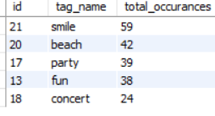
Hashtag Research
A partner brand wants to know the most popular hashtags to use in their posts to reach the most people.
My Task: Identify and suggest the top five most commonly used hashtags on the platform.
Query:
Output:
Top 5 most commonly used hashtags on the platform are smile, beach, party, fun and concert.

Slide 9

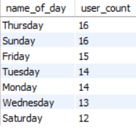
Ad Campaign Launch
The team wants to know the best day of the week to launch ads.
My Task: Determine the day of the week when most users register on Instagram. Provide insights on when to schedule an ad campaign.
Query:
Output:
Above are the registrations that occur in a week. Most registrations occur on Thursday and Sunday. Therefore, launching ads on Thursday’s and Sunday’s is recommended.

Slide 10

B) Investor Metrics: User Engagement
Investors want to know if users are still active and posting on Instagram or if they are making fewer posts.
My Task: Calculate the average number of posts per user on Instagram. Also, provide the total number of photos on Instagram divided by the total number of users.
Query:
Output:
Average number of posts per user on Instagram is 2.5700

Slide 11

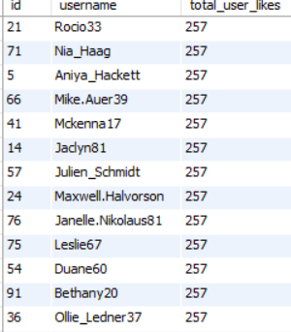
Bots & Fake Accounts
Investors want to know if the platform is crowded with fake and dummy accounts.
My Task: Identify users (potential bots) who have liked every single photo on the site, as this is not typically possible for a normal user.
Query:
Output:
List of users who liked every single photo, identified as potential bots.

Slide 12
Insights
Loyal Users: Identifying the oldest users, recognizing and rewarding loyal users can enhance user retention.
Inactive Users: Identifying and targeting inactive users by using promotional content can increase user engagement.
Contest Engagement: Competitions promote user interaction and can be used strategically for marketing campaigns.
Popular Hashtags: Most commonly used hashtags can reveal trending topics among users Using trending hashtags can increase the visibility and reach of Instagram posts.
Ad Campaign Timing: Scheduling ads on the day with the highest user registrations can maximize ad reach and optimize ad campaign schedule.
User Engagement Metrics: Providing average posts per user helps assess overall Instagram platform activity. Decrease in the metric might indicate lower user activity.
Bot Detection: Identifying bots ensures a cleaner, more genuine user base on Instagram. This is important for maintaining the integrity of user interactions and metrics on the platform.

Slide 13
Conclusion
The analysis provides valuable insights for marketing strategies.
The insights gained from this project includes understanding user behavior, identifying trends, and uncovering potential issues such as bot activity
This project will allows me to apply my SQL skills to real-world tasks related to marketing analysis.
This project demonstrates the importance of data-driven decision-making.

